Slide 1

INTERVIEW SKILLS
AND TECHNIQUES
Prepared By :
Advanced Institute of Accounts & Taxation Pvt Ltd

Slide 2

INTERVIEW
Definition for interview
Types of interview
Preparation for interviews
Performance during and after interviews
Some Tips for interviews
Do’s and Don’ts
Interview questions

Slide 3
Interview
A meeting of minimum two expert-candidate
Arranged to examine the suitability of the candidate
Tested for subject knowledge, skills and desired behavior in a very limited time

Slide 4
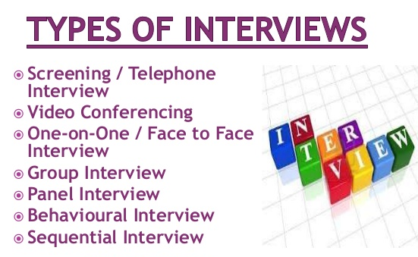

Types of Interview
Panel Interview: three or more experts sit across table from the candidate.
Face-to-Face Interviews: one interviewer one candidate.
informal in nature
less distance between interviewer and candidate
less stressful and relaxed environment compared to panel interview

Slide 5
Prior interviews
Read your CV/ application and skills demanded
Know the company
Go to the company web site
Annual reports
Business news papers, magazines
Directly contact the employees

Slide 6

Know the Company
Main production / service
Annual sales, profit, dividend
Competitors
Area of operation
New product service launched

Slide 7
During an interview
Employers Evaluate
Self Confidence – you should be confident while appearing for interview
Interpersonal skills – fluency in English, listen attentively and answer to the questions asked by the interviewer
Be honest – While answering in the interview, even if you don’t know the answer for certain question, be honest in answer to the interviewer.

Slide 8
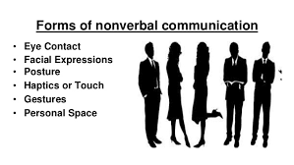
Non- verbal or Body Language
Posture: sit erect without learning on the desk or slouching in the chair, but don’t be stiff and tense
Always make eye contact when you speak, but avoid continuous staring
Don’t use too many hand movements and frequent change of facial expressions not in relation to words you have expressed

Slide 9

Dress outlook
Dress formally and well groomed
You will never get a second chance to make a good impression
Wear something that make you feel comfortable
Use simple accessories like simple jewelry, watches, ties, etc
Scents, perfumes and after shaves lotion should be avoided

Slide 10

HOW TO SHAKE HANDS
Smile and make eye contact as you shake hands.
Extend your hand; your palm should touch the palm of the interviewer
Use a firm handshake; adjust your grip to the other person’s hand.
Hold the handshake for 2 to 3 seconds making a slight up and down pumping motion.

Slide 11

Expected qualities of the candidate
Effective Verbal communication If it is English, Hindi Or Marathi Speak Fluently Natural delivery, fluency Pronounce sentence clearly Speak little more loudly or lower your voice to draw attention of the experts if there is an important point or opinion

Slide 12
Rejected by the committees
Vague and irrelevant answers to the questions
Very fidgety: little eye contact; nervous mannerism, such as playing with hair, nail biting etc.
Lack of sincerity
Utter superficial remarks to impress the interviewer – project work

Slide 13
Do’s
Do take a practice run to the location where you are having the interview
If presented with a job application, do fill it out neatly, completely and accurately
Do bring extra resumes to the interview
Do greet the interviewer & do shake hands firmly
Do wait until you are offered a chair before sitting.

Slide 14
Do’s
Do make good eye contact with your interviewer(s)
Do show enthusiasm in the position and the company
Do make sure that your good points come across to the interviewer in a factual sincere manner
Do stress your achievements

Slide 15
DON’TS
Do avoid controversial topics
Don’t ever lie. Answer questions truthfully, frankly
Don’t say anything negative about former colleagues, supervisors, or employers
Don’t answer questions with a simple ‘yes’ or ‘no’. Explain whenever possible. Describe those things about yourself that showcase your talents, skills and determination. Give examples

Slide 16
DON’TS
Don’t inquire about salary, vacations, bonuses, retirement, or other benefits until after you’ve received an offer
Don’t bring up or discuss personal issues or family problems
Don’t say your past history, hence it is available in the C.V. itself

Slide 17
After Interview
Thank them for calling you for the interview through a letter
Indicate that you look
forward to hear from
them.

Slide 18
INTERVIEW QUESTIONS
Tell me about yourself
Why did you leave your previous job?
What sort of job you are looking for?
What appeals to you about this job?
Why do you think you’d be good at this job?
What are your strengths?
What are your weaknesses?
Would you accept this job if it were offered to you?
What do you know about this company?
If you take this job, how long would you stay?
Don’t you think you may be too
old/young/inexperienced?

Slide 19
Tell me about yourself
The most often asked question in interviews
Tell your academic record
Your skills
Your qualification etc.
Talk about things you have done and jobs you have held that relate to the position you are interviewing for
Time: 3 minutes
Prepare written answer for this question and rehearse

Slide 20
What do you think you do
be good at this job?
The best is to say general and say something like: A job where I love to work, like the people, can contribute more to the company
A job which is challenging, a job which gives me opportunities to prove knowledge and skills

Slide 21
What are your strengths ?
Strength of your subject knowledge
Your ability to prioritize,
Your problem –solving skills,
Your ability to work under pressure,
Your ability to focus on projects,
Your professional expertise,
Your leadership skills and
Your positive attitude.

Slide 22
What are your weakness ?
Here you have to tell your weakness As strength
Eg Always I will be committed to the assigned work, which I expect from my coworkers, this leads to affects the interpersonal relationship but the outcome of the work will be satisfied. This eg suits to the team leader.

Slide 23
Would accept this job, if were offered to you ?
Yes, certainly I will accept this job do the best to the company or organization.
No, you have give reason.

Slide 24
What do you know about this company ?
You have to go to the website and look for the details like company, products, services, year of starting the company, their annual reports, agenda. How many workers are working in that company, volume of the business future plan of business and other specific details.

Slide 25
If you take this job, how long would you stay ?
You set high standards for yourself and meet them.
Your outcomes are a success and tell them about you stay in that company.

Slide 26
Don’t you think you may be too old/ young/inexperienced ?
Admit that you have no experience. However explain your academic strength.

Slide 27
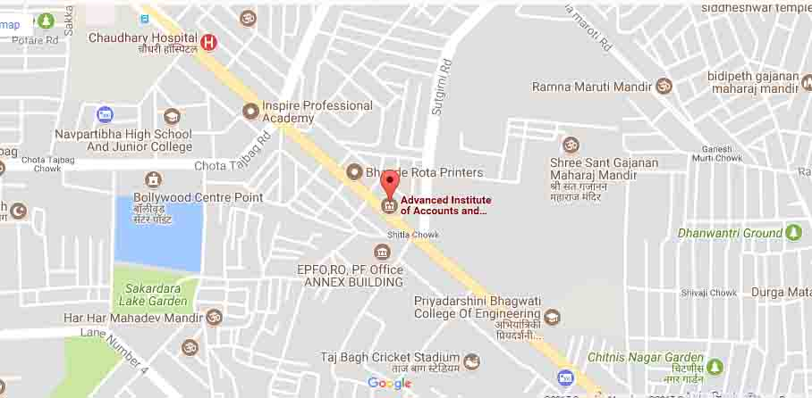
CONTACT US
Head Office :
Advance Institute of Accounts & Taxation Pvt Ltd 15 Bhande Plot, Umred Road, Near Shitala Mata Mandir, Nagpur
Email At: info@aiatindia.com
Call : +919373104022
712-2714080

Slide 28

Visit us : www.aiatindia.com

